Slide 1
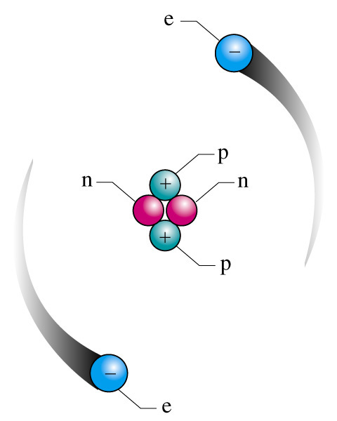
Chemistry
Raymond Chang
Matter, Atoms, Molecules and Ions
Chemistry: Chapter 1 and 2
Slide <number> of 25
Notes:
Chemistry 140 Fall 2002

Slide 2
Contents
Matter, Substance, Mixture, Element & Compound
Constituents of atom
Atomic number
Mass number
Isotopes
Molecules and ions
Mole and Avogadro constant
Orbital
Introduction to periodic table
Slide <number> of 25
General Chemistry: Chapter 2
Prentice-Hall © 2002

Slide 3
What is Chemistry?
Chemistry is the study of matter and the changes it
undergoes.
Slide <number> of 25
General Chemistry: Chapter 2
Prentice-Hall © 2002

Slide 4
Matter
Matter is anything that occupies space and has mass.
Matter includes things we can see and touch
( such as water, trees, and earth).
Matter also includes things we can not see and
touch ( such as air ).
Slide <number> of 25
General Chemistry: Chapter 2
Prentice-Hall © 2002

Slide 5
Substance and Mixtures
A substance is a form of matter that has a fixed
(constant) composition and distinct properties.
Examples: water, sugar, salt, gold and oxygen.
Substances differ from one another in composition
and can be identified by their smell, taste, appearance
and other properties.
Slide <number> of 25
General Chemistry: Chapter 2
Prentice-Hall © 2002

Slide 6
Mixtures
A mixture is a combination of two or more
substances in which the substances retain their
distinct identities.
Example: air, soft drinks, milk, and cement.
Mixtures do not have constant composition.
Slide <number> of 25
General Chemistry: Chapter 2
Prentice-Hall © 2002

Slide 7
Mixtures
Mixtures are two types:
Homogeneous and heterogeneous
Homogenous mixture:
Homogenous mixture is a mixture in which the
composition of the mixture is the same throughout.
When sugar dissolves in water we get a
homogeneous mixture.
Slide <number> of 25
General Chemistry: Chapter 2
Prentice-Hall © 2002

Slide 8
Mixtures
Heterogeneous mixture:
Heterogeneous mixture is a mixture where
composition is not uniform.
If sand is mixed with iron filings, the sand grains
and the iron filings remain separate. This a
heterogeneous mixture.
Slide <number> of 25
General Chemistry: Chapter 2
Prentice-Hall © 2002

Slide 9
Elements and Compounds
Substances can be either elements or compounds.
Element:
An element is a substance that cannot be separated
into simpler substances by chemical means.
Chemists use symbols of one or two letters to
represent the elements (Example: Al, Fe, Co).
Slide <number> of 25
General Chemistry: Chapter 2
Prentice-Hall © 2002

Slide 10
Element
An element is a substance (for example, carbon, hydrogen,
and iron) that consists of identical atoms.
At this time, 116 elements are known.
Of these, 88 occur in nature; chemists and physicists have
made the others in the laboratory.
Slide <number> of 25
General Chemistry: Chapter 2
Prentice-Hall © 2002

Slide 11
Compounds
Compound:
A compound is a substance composed of atoms of two
or more elements chemically united in fixed
proportions.
Slide <number> of 25
General Chemistry: Chapter 2
Prentice-Hall © 2002

Slide 12
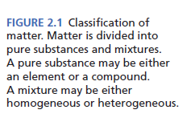
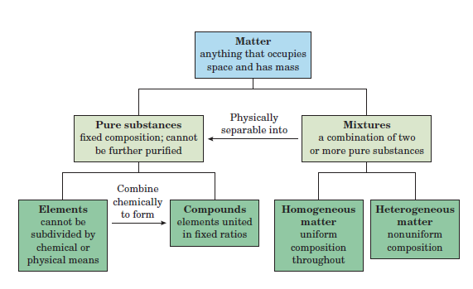
Matter
Slide <number> of 25
General Chemistry: Chapter 2
Prentice-Hall © 2002

Slide 13
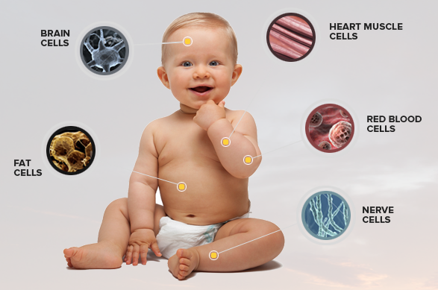
Atom
Living things consist of atoms of different elements
An element is one type of atom
Human body is made of some 50 trillion to 100 trillion cells
Slide <number> of 25
General Chemistry: Chapter 2
Prentice-Hall © 2002

Slide 14
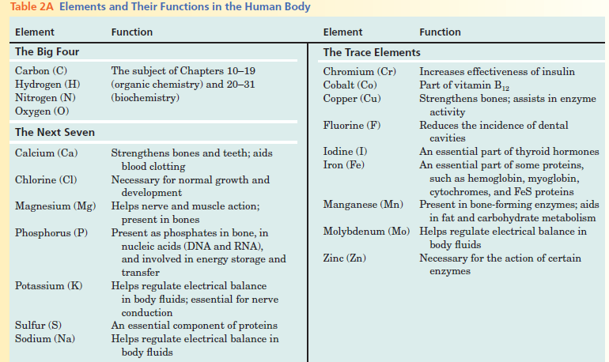
Elements and their functions in human body
Slide <number> of 25
General Chemistry: Chapter 2
Prentice-Hall © 2002

Slide 15
Atom
An element is one type of atom
An atom is one of the basic units of matter.
Everything around us is made up of atoms.
An atom is a million times smaller than the thickest
human hair.
Slide <number> of 25
General Chemistry: Chapter 2
Prentice-Hall © 2002

Slide 16
Atom
An atom consists of a very dense central nucleus made
up of protons and neutrons, plus electrons that move
about the nucleus at a relatively large distance from it.
Protons are positively charged, neutrons have no charge,
and electrons are negatively charged.
Slide <number> of 25
General Chemistry: Chapter 2
Prentice-Hall © 2002

Slide 17
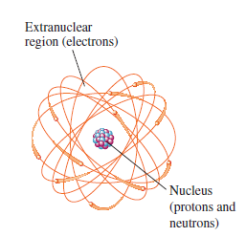
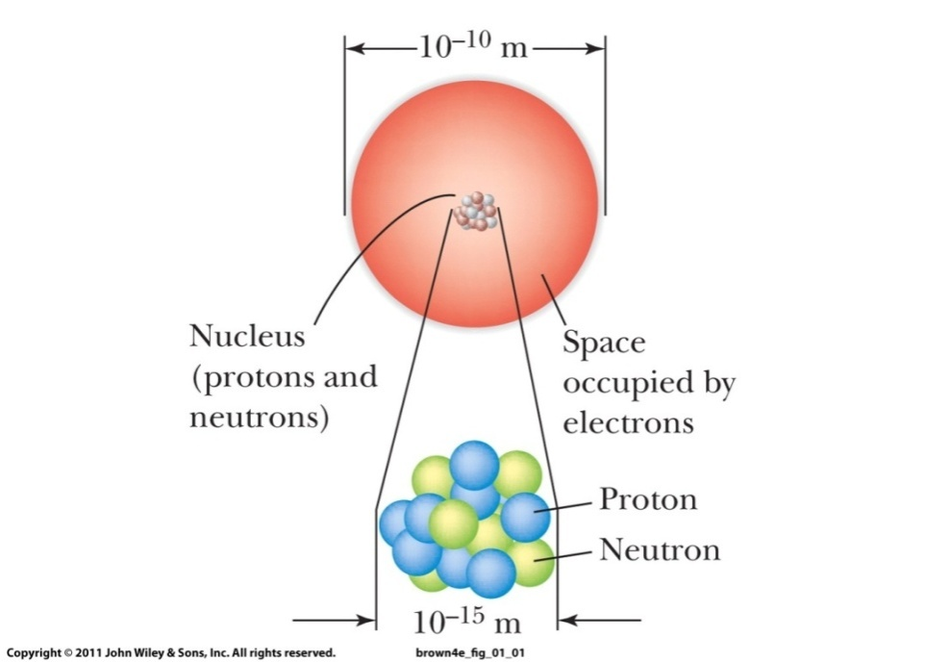
Atom
Diameter of a nucleus is about 10⁻¹² cm
Diameter of an atom: 10⁻⁸ cm
Electrons circulate around the nucleus at a distance of approximately 10⁻¹⁰ m.
Slide <number> of 25
General Chemistry: Chapter 2
Prentice-Hall © 2002

Slide 18
Atom
Atoms are made up of subatomic particles called electrons,
protons, and neutrons.
2. The protons and neutrons form a tiny, dense, central body
called the nucleus of the atom.
3. The electrons are distributed in space around the nucleus.
Neutrons are uncharged subatomic particles with nearly the
same mass as protons. They are located in the nuclei of atoms.
Slide <number> of 25
General Chemistry: Chapter 2
Prentice-Hall © 2002

Slide 19
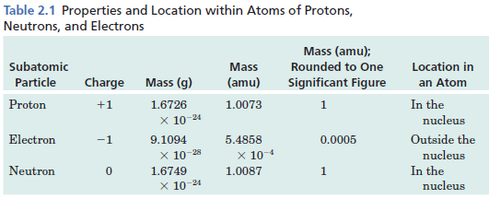
Comparison of Subatomic Particles
The mass of a proton is 1.6726 x 10⁻²⁴ g, but this number is so small that
it is more convenient to use another unit, called the atomic mass unit (amu).
Slide <number> of 25
General Chemistry: Chapter 2
Prentice-Hall © 2002

Slide 20
Problem
Q1. Mass of a carbon atom is 1.99 x 10⁻²⁶ kg. How many carbon atoms
are present in a sample of carbon of mass 10 g?
Slide <number> of 25
General Chemistry: Chapter 2
Prentice-Hall © 2002

Slide 21
Solve
Q1. Mass of a carbon atom is 1.99 x 10⁻²⁶ kg. How many carbon atoms
are present in a sample of carbon of mass 10 g?
Solve:
Mass of sample
Number of carbon atoms =
Mass of one atom
1.00 x 10⁻² kg
=
1.99 x 10⁻²⁶ kg
=
5.03 x 10²³
Slide <number> of 25
General Chemistry: Chapter 2
Prentice-Hall © 2002

Slide 22
Scale of Atoms
Useful units:
1 amu (atomic mass unit) = 1.66054 x 10⁻²⁴ kg
1 pm (picometer) = 1 x 10⁻¹² m
1 Å (Angstrom) = 1 x 10⁻¹⁰ m = 100 pm = 1 x 10⁻⁸ cm
Slide <number> of 25
General Chemistry: Chapter 2
Prentice-Hall © 2002

Slide 23
Atomic number and mass number
Atomic number (Z):
Number of protons in the nucleus of each atom of an element is called
the atomic number (Z).
Atomic number (Z) = No. of protons in atom’s nucleus
= No. of electrons around atom’s nucleus
Mass number (A):
Mass number (A) is the total number of neutrons and protons present
in the nucleus of an atom of an element.
Slide <number> of 25
General Chemistry: Chapter 2
Prentice-Hall © 2002

Slide 24
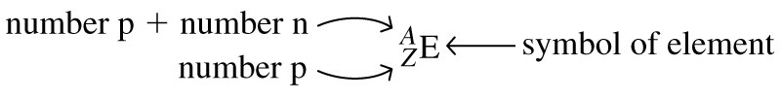

Atomic number and mass number
To represent a particular atom we use the symbolism:
A= mass number Z = atomic number
Slide <number> of 25
General Chemistry: Chapter 2
Prentice-Hall © 2002
Notes:
Chemistry 140 Fall 2002
Often do not specify Z when writing. For example ¹⁴C, C specifies Z = 12.
Special names for some isotopes. For example hydrogen, deuterium, tritium.

Slide 25
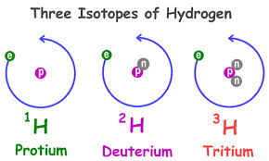
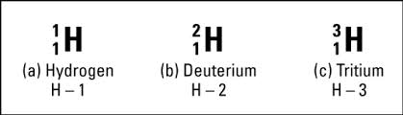
Isotope
Atoms with identical atomic numbers but different mass numbers
are called isotopes.
Hydrogen has three isotopes.
(Non radioactive)
(Non radioactive)
(Radioactive)
Slide <number> of 25
General Chemistry: Chapter 2
Prentice-Hall © 2002

